Slide 1
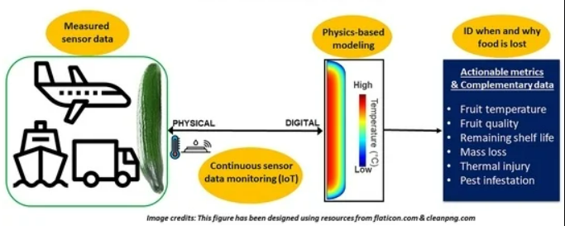
QA SIMULATION PROJECT
Nithya Viswanathan
Sekar Gayathri
Lauri Kyttälä
Suman Basnet

Slide 2
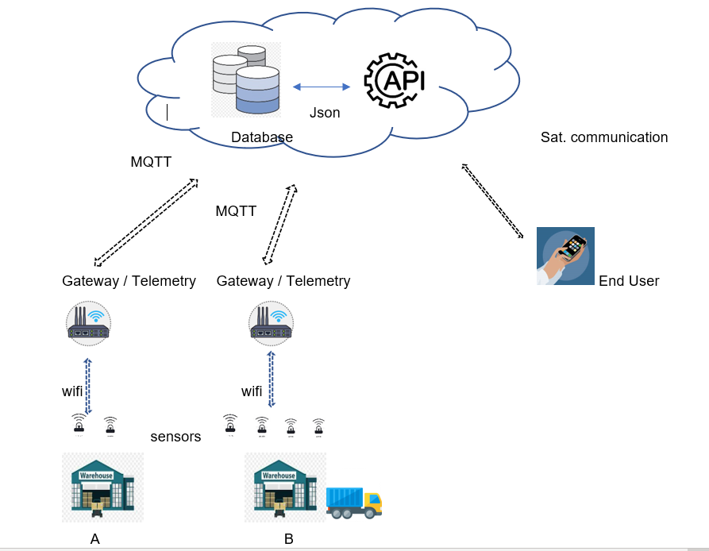
SMART-SENSOR Mobile TESTING

Slide 3
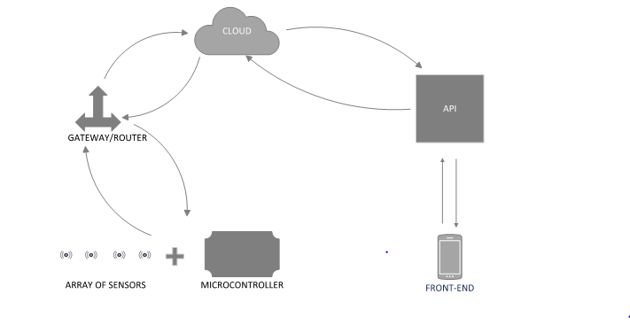
SMART-SENSOR Mobile TESTING
Test Methodology :: Agile Method
TesModules ::
Module 1 :: SmartSensor ---------- Cloud
SUB-MODULE 1 :: SmartSensor
SUB-MODULE 2 :: SmartSensor to Gateway
SUB-MODULE 3 :: Gateway to Cloud
Module 2 :: Cloud ---------- Mobile / Desktop
SUB-MODULE 4 :: Cloud to API
SUB-MODULE 5 :: API to End User
Figure : Representation of Work-Flow

Slide 4
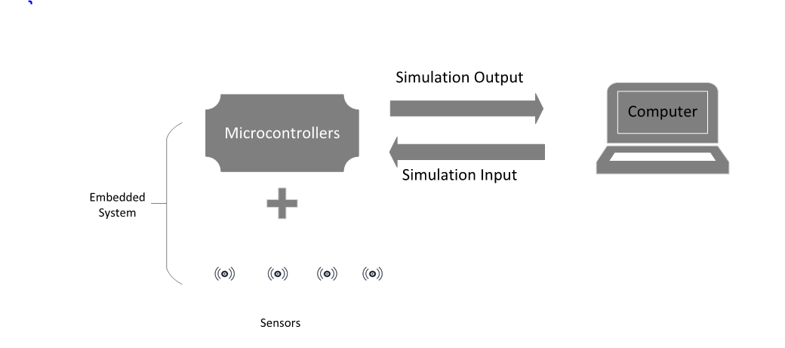
MODULE 1 :: SmartSensor ---------- Cloud SUB-MODULE 1 :: SmartSensor Test Environment
Test Levels
Usability testing (easy for end user/tester)
Security testing (To test the data is encrypted)
Functionality (High level)
Tools
WireShark, Shodan
Figure : Testing at Embedded Side

Slide 5
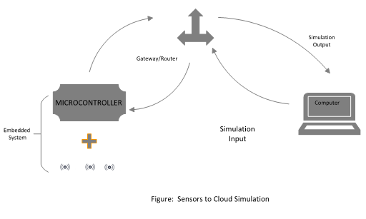
SUB-MODULE 2 :: SmartSensor to Gateway
Test level ::
Network testing (connectivity)
Security testing (Encrypted data)
Performance testing (supports multiple sensor / 24 x7)
Compatibility testing (Between sensor and Gateway)
Tools
Spirent (to trigger packet and check authenticity)
Automation
Network testing, Performance testing
Test Environment

Slide 6
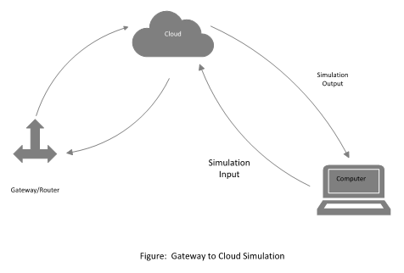
SUB-MODULE 3 :: Gateway to Cloud
Test Levels
Network testing (Connectivity)
Performance testing (multiple sensor / 24 x7)
Security testing (MQTT)
Stability testing (Load)
Tools
Spirent (to trigger packet and check authenticity)
Test Environment

Slide 7
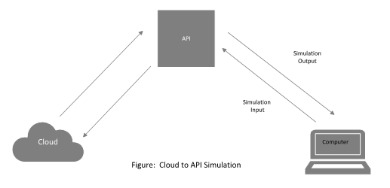
MODULE 2 :: CLOUD ---------- MOBILE / DESKTOP SUB-MODULE 4 :: CLOUD to API
Test level::
Performance testing (Load, Scalability, Stress)
Functionality (Error handling, Parameters tested, Negative testing , Decryption data)
Test tools :: Jmeter, PostMan
Automation :: Functionality , Performance testing
Test Environment

Slide 8
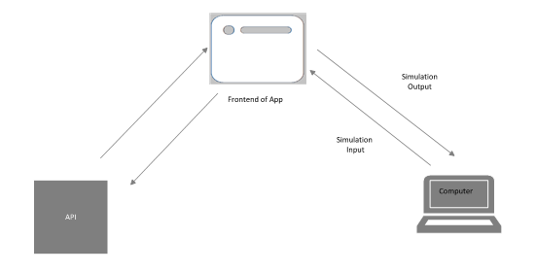
SUB-MODULE 5 :: API to Mobile
Test levels
Functionality (UI, Trigger Alert)
Performance testing (load, scalability, Stress)
Compatibility(Android/iOS),Usability
Tools
Jmeter for performance testing , PostMan for functionality testing, BURP for security testing
Automation
Functionality, Performance (More focus)
Test Environment
Figure: API to Frontend Testing

Slide 9
SmartSensor to End User (End-to-End testing)
Test levels
End to End complete system testing (Performance)
At the end will do a Pilot testing before handling it to the Stakeholders!
Test tools
Jmeter for performance testing
Automation
Performance

Slide 10
Automation tools:
Robot Framework, Jmeter, PostMan, BURB
Defect Tracking & Test Project Management
JIRA

Slide 11
Thank you!!!! Q&A

